Slide 1
HND Computing Systems Development: Object Oriented Analysis and Design (H172 35)
Lecturer – Dawn Wilson

Slide 2
Moodle
Default username and password = matriculation number
Login and edit your profile to update your email address

Slide 3
Object-oriented Methods
A technique for system modelling
Easy to understand
Directly related to reality
Natural partitioning of the problem
More flexible and resilient to change
Provides integrated view of hardware and software
Provides a methodology for system development
How?
We model a system as a number of objects that interact

Slide 4

Objects
3 things to describe an object:
IDENTITY – have their own independent existence
ATTRIBUTES – own characteristics that describe them
BEHAVIOUR – things they can do
But objects are not always physical or visible therefore
difficult to identify objects
Ways to identify an object:
NOUN – is the word a noun?
“the” – could you put the word “the” in front of it?
Notes:
Activity: split into 5 groups and write down the identity/attributes/behaviour of – phone, aeroplane, car, person, t.v.
Then pick your own object to describe

Slide 5




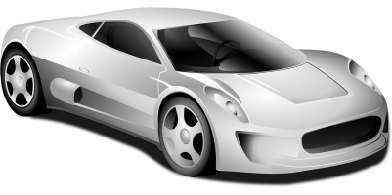
Object Activity
Using the 3 categories to describe an object
Identity
Attributes
Behaviour
Describe the following:

Slide 6
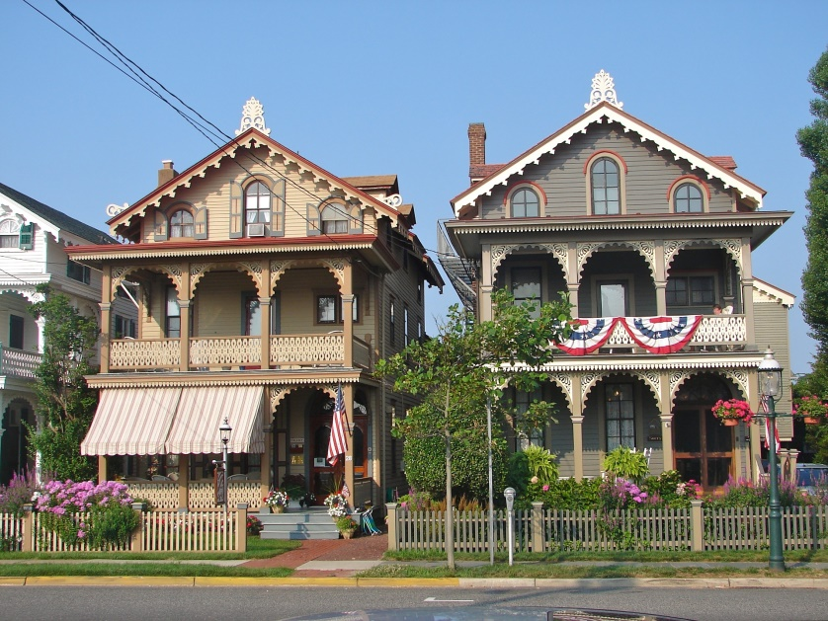
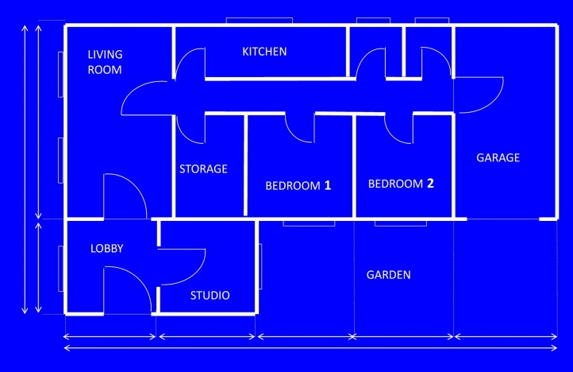

How do we make objects? - CLASS
Describes what an object will be BUT is not the object itself
It is a blueprint
Use the class to create the object
Could create 1000 objects from one class!

Slide 7

How do we make objects?

Slide 8
Creating a class
TYPE
name: what is it?
employee, bank account, event, player, document, album
PROPERTIES DATA
attributes: what describes it?
Width, height, colour, score, file type, length
behaviour: what can it do?
Play, open, search, save, print, create, delete, close

Slide 9

Example: Bank Account Class
name: BankAccount
attributes: accountNumber, balance, dateOpened, accountType
behaviour: open, close, deposit, withdraw
Information represented in a CLASS DIAGRAM (UML)
BankAccount
DawnAccount
accountNumber
balance
dateOpened
accountType
A7652
£500
3/5/2000
current
open()
close()
deposit()
withdraw()
open()
close()
deposit()
withdraw()

Slide 10
Guidelines for classes
What have we learned so far?
we are modelling solutions based on interacting objects
We create classes as the “templates” for these objects, and the objects themselves are instances of the class
How should we go about creating classes for our solution?
We need to understand the 4 principles of OO to help us understand how best to create our classes for our solution
Remember, that although we should always think about the 4 principles of OO when designing our solution, we cannot address all of these on the 1st iteration.
We just need enough to let us move forward successfully

Slide 11
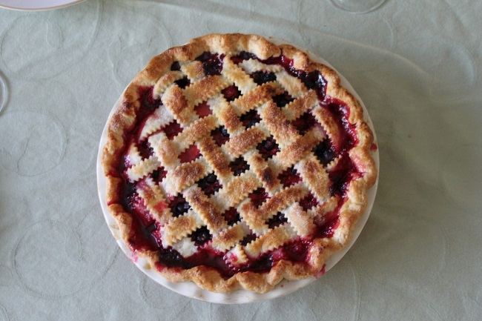
4 Pillars of OO
“A PIE”
Abstraction
Polymorphism
Inheritance
Encapsulation

Slide 12
Abstraction
An idea/concept that is completely separate from any specific instance
You understand the idea of a table without having to say it’s wooden or glass etc.
we use abstraction to gather the general characteristics and to filter out of the details we do not need in order to solve our problem
Focus on the essentials
Ignore the irrelevant
Ignore the unimportant
Why abstraction?
Reduces complexity and increases efficiency
Notes:
We noted that all cats have general characteristics, which are common to all cats, eg eyes, a tail, fur, a liking for fish and the ability to make meowing sounds. In addition, each cat has specific characteristics, such as black fur, a long tail, green eyes, a love of salmon, and a loud meow. These details are known as specifics.
In order to draw a basic cat, we do need to know that it has a tail, fur and eyes. These characteristics are relevant. We don't need to know what sound a cat makes or that it likes fish. These characteristics are irrelevant and can be filtered out. We do need to know that a cat has a tail, fur and eyes, but we don't need to know what size and colour these are. These specifics can be filtered out.
From the general characteristics we have (tail, fur, eyes) we can build a basic idea of a cat, ie what a cat basically looks like. Once we know what a cat looks like we can describe how to draw a basic cat.

Slide 13
Encapsulation
Think capsule…idea of surrounding something to keep contents together and to protect the contents
Keep contents together – taking attributes and behaviours and bundling them together
Protect the contents – an object should not reveal anything about itself other than that what is absolutely necessary for other parts of the application to work. This is known as information/data hiding.
Close off data and inner-workings with the exception of what we choose to make public, normally for input and output
How much should we hide? – As much as possible!
Why encapsulation?
It’s about reducing dependencies between different parts of the application

Slide 14
Inheritance
Inheritance allows a software developer to derive a new class from an existing one:
Existing class = parent, super, or base class.
Derived class = child or subclass.
The child class inherits characteristics of the parent.
All attributes and methods defined for the parent class.
Any changes to the parent filter down to the child class
The child can also have its own unique behaviors and data.
Why inheritance?
Code re-use
Easy modification of model – modify one place
Avoid redundancy leading to smaller, more efficient, easier to understand models

Slide 15
Inheritance
Person
name
email
phone
Parent class
(super class / base class)
changeEmail()
Don’t want to add customerNumber to Person class as trying to use abstraction – focus on essentials as not all Person objects will be a Customer
Customer
name
email
Phone
customerNumber
Child class
(sub class / derived class)
changeEmail()
Multiple inheritance used by C++, single inheritance used by C#

Slide 16
How to identify inheritance
Inheritance should create an “IS A …” relationship
A car IS A vehicle – Yes, inheritance
A bus IS A vehicle – Yes, inheritance
A car IS A bus – no, not inheritance
Could also say “is a kind of…” or “is a type of…”
pick out all of your nouns to help identify your objects
Think about whether there are any “is a” relationships between any of your objects
Don’t go looking for inheritance and over-emphasise it. You will come across classes that have similar attributes/behaviours. You may then create a superclass and strip out similar behaviours and put them in the parent class

Slide 17
Class Hierarchies
A child class of one parent can be the parent of another child, forming a class hierarchy
Animal
Reptile
Bird
Mammal
Snake
Lizard
Parrot
Horse
Bat

Slide 18
Inheritance in action
All classes in C# are derived from the Object class
if a class is not explicitly defined to be the child of an existing class, it is a direct descendant of the Object class
The Object class is therefore the ultimate root of all class hierarchies.
The Object class defines methods that will be shared by all objects in C#, e.g.,
ToString: converts an object to a string representation
Equals: checks if two objects are the same
GetType: returns the type of a type of object
A class can override a method defined in Object to have a different behavior, e.g.,
String class overrides the Equals method to compare the content of two strings

Slide 19
Activity
Discuss then represent a shape hierarchy
Use the UML representation of a class i.e. include attributes and behaviours
In UML, inheritance is shown as an open arrow pointing to the object it is inheriting from

Slide 20

Polymorphism
Means “many forms”
A child class can override the definition of an inherited method in favor of its own
That is, a child can redefine a method that it inherits from its parent
The new method must have the same signature as the parent's method, but can have a different implementation.
Same object has different implementations and it is the type of the object executing the method that determines which version of the method is invoked. This is resolved at run-time, not during compilation, and is known as dynamic binding.

